Slide 1
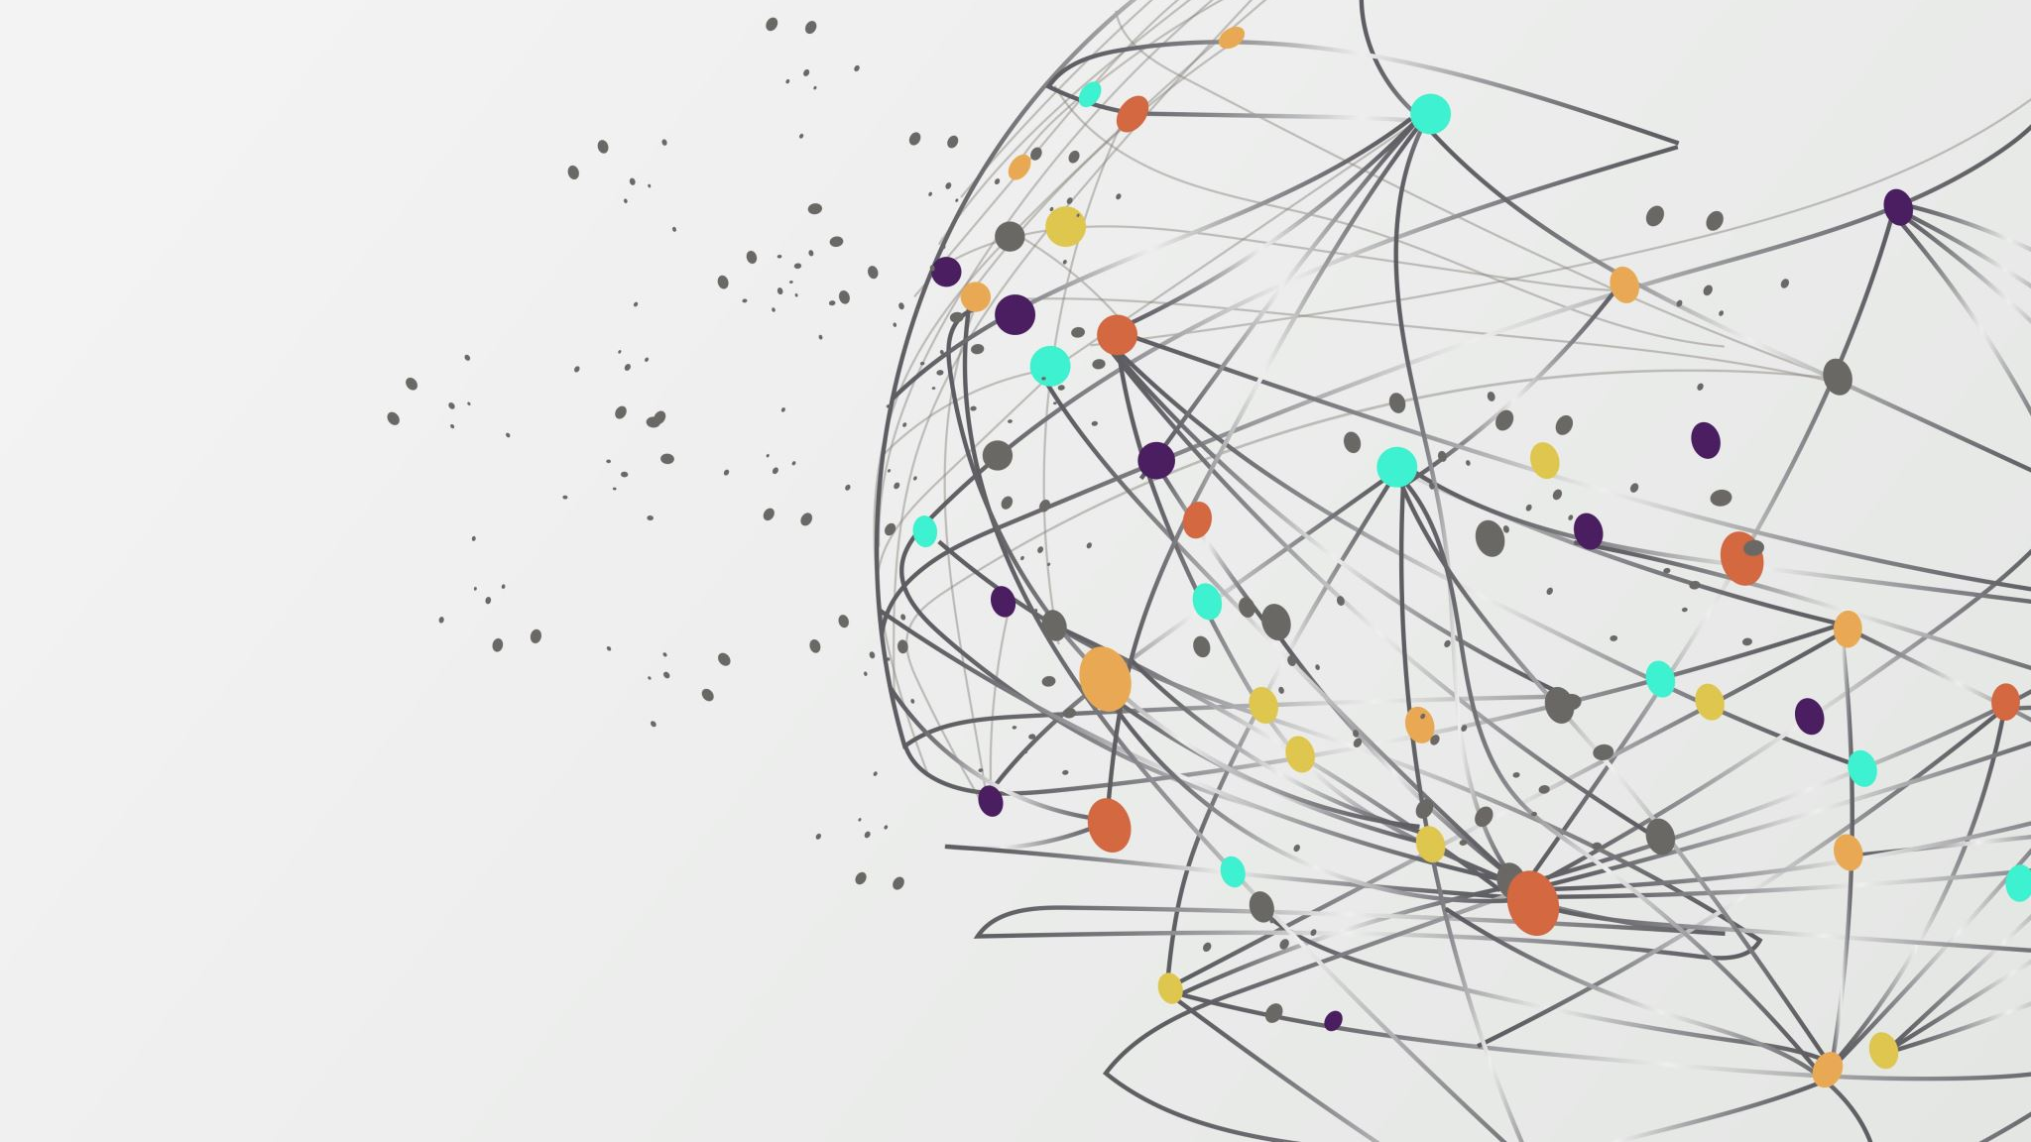
What is a Web API?
Learn to Produce Effective Web APIs with ASP.NET 7

Slide 2

Where to get the Code!!!
https://github.com/cwoodruff/web-api-workshop
Workshop Website
https://cwoodruff.github.io/web-api-workshop/

Slide 3

What is a Web API?
In computer programming, an application programming interface (API) is a set of subroutine definitions, protocols, and tools for building software and applications.

Slide 4
So what is a Web API?
Ideal for building RESTful services
Supports HTTP
Uses HTTP Requests and Responses
Maps to HTTP verbs

Slide 5

Where did Web APIs come from?

Slide 6
Types of Web Services
01
Remote Procedure Call (RPC)
02
Simple Object Access protocol (SOAP)
03
Representational State Transfer (REST)
Calls over HTTP
04

Slide 7
Evolution of Services

